Slide 1
Pandemic paths towards endemicity?
Ottar N. Bjornstad
Center for Infectious Disease Dynamics, Pennsylvania State University
onb1@psu.edu
www.cidd.psu.edu

Slide 2
Zoonoses 1-4
Justinian
plague
New world
Smallpox
Justinian
plague
14th C
50%+ Europe
6th C
50% Eurasia
Black
death
16th C
25%+
Old world syphilis
Flu X?
1918 100M
HIV
A/H1N1
2019 10M
1850ish
Spanish flu
A/H1N1
1981 35M
2009
COVID

Slide 3
Influenza A/H1N1/2009 was a
Bird-pig-human reccombinant
Influenza A/H1N1 movie
Spatial diffusion
Diary studies school
time contacts
Regular school openings in 2009
Fueled the epidemic

Slide 4
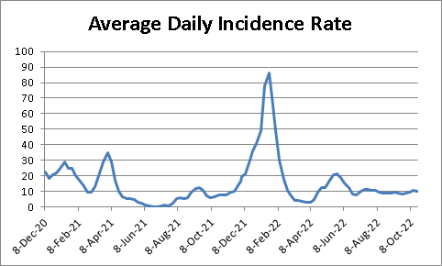
Covid-19 pandemic – What is an RNA virus and why such fast evolution
(Cancer is caused by mutations in human cells)

Slide 5
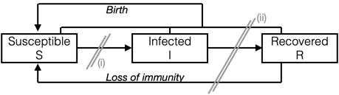
Compartmental flows
Pc=1-1/R0
=> Herd immunity

Slide 6

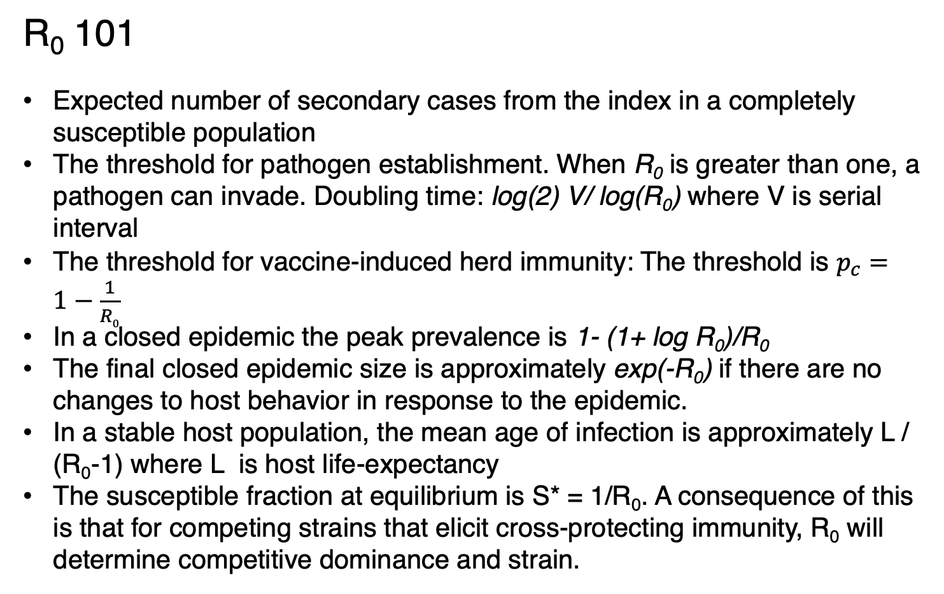
R₀ 101
Expected number of secondary cases from the index in a completely susceptible population
The threshold for pathogen establishment. When R₀ is greater than one, a pathogen can invade. Doubling time: log(2) V/ log(R₀) where V is serial interval
The threshold for vaccine-induced herd immunity: The threshold is $p_{c}=1−\frac{1}{R0}$
In a closed epidemic the peak prevalence is 1- (1+ log R₀)/R₀
The final closed epidemic size is approximately exp(-R₀) if there are no changes to host behavior in response to the epidemic.
In a stable host population, the mean age of infection is approximately L / (R₀-1) where L is host life-expectancy
The susceptible fraction at equilibrium is S* = 1/R₀. A consequence of this is that for competing strains that elicit cross-protecting immunity, R₀ will determine competitive dominance and strain.
“Natural herd immunity” is a myth at endemic equilibrium R_{E} = 1/S*=1

Slide 7
COVID 19 and transition to
Transition to endemicity
Global SARS-CoV2 IFRs
Age (yrs)

Slide 8
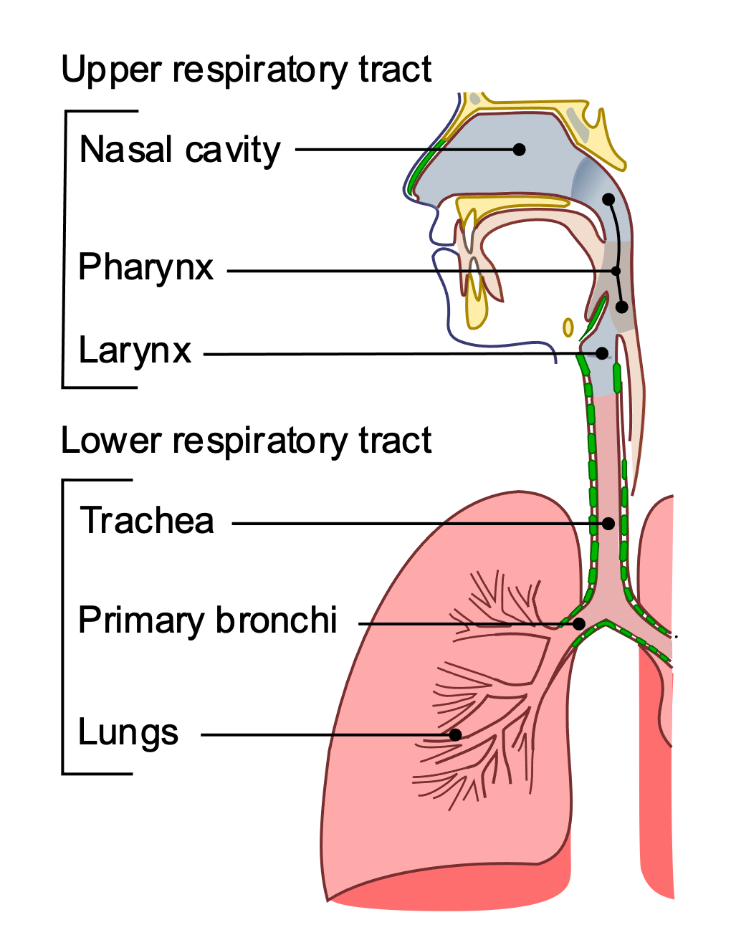
Covid is a bat virus
Immunity is toxic
Permissive tissues
“Breaktrough infections”
“Loss of immunity”

Slide 9
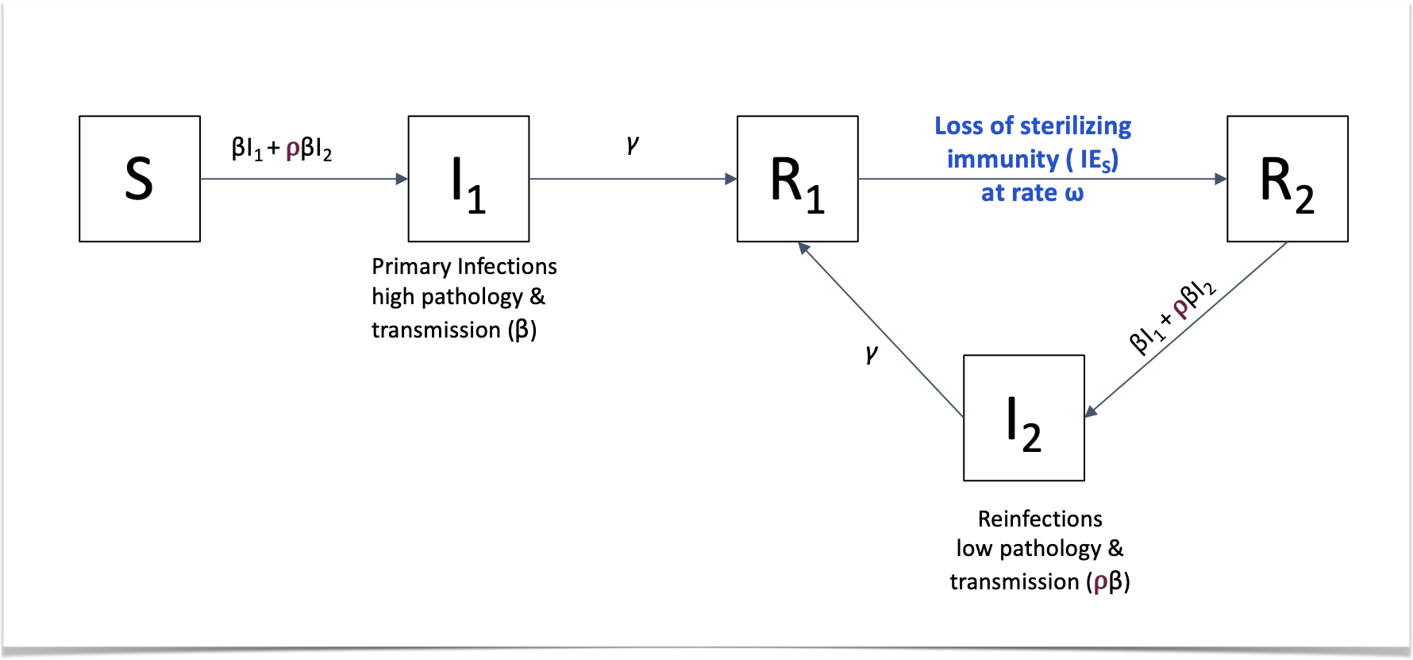

Slide 10
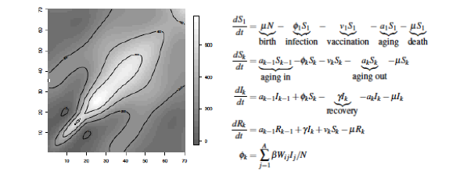

Slide 11
Age-specific relative risk of primary infection

Slide 12
Strain replacement

Slide 13
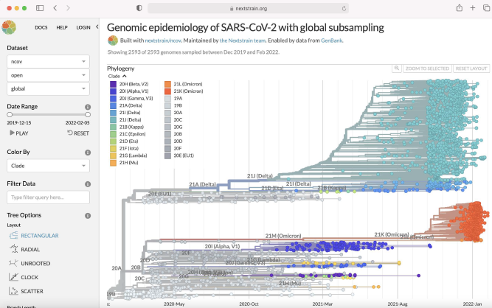
What we didn’t expect

Slide 14
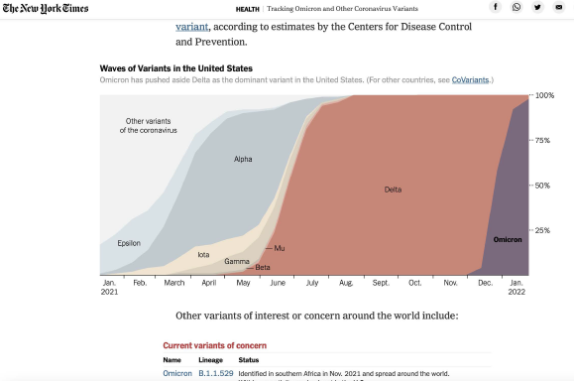

Slide 15
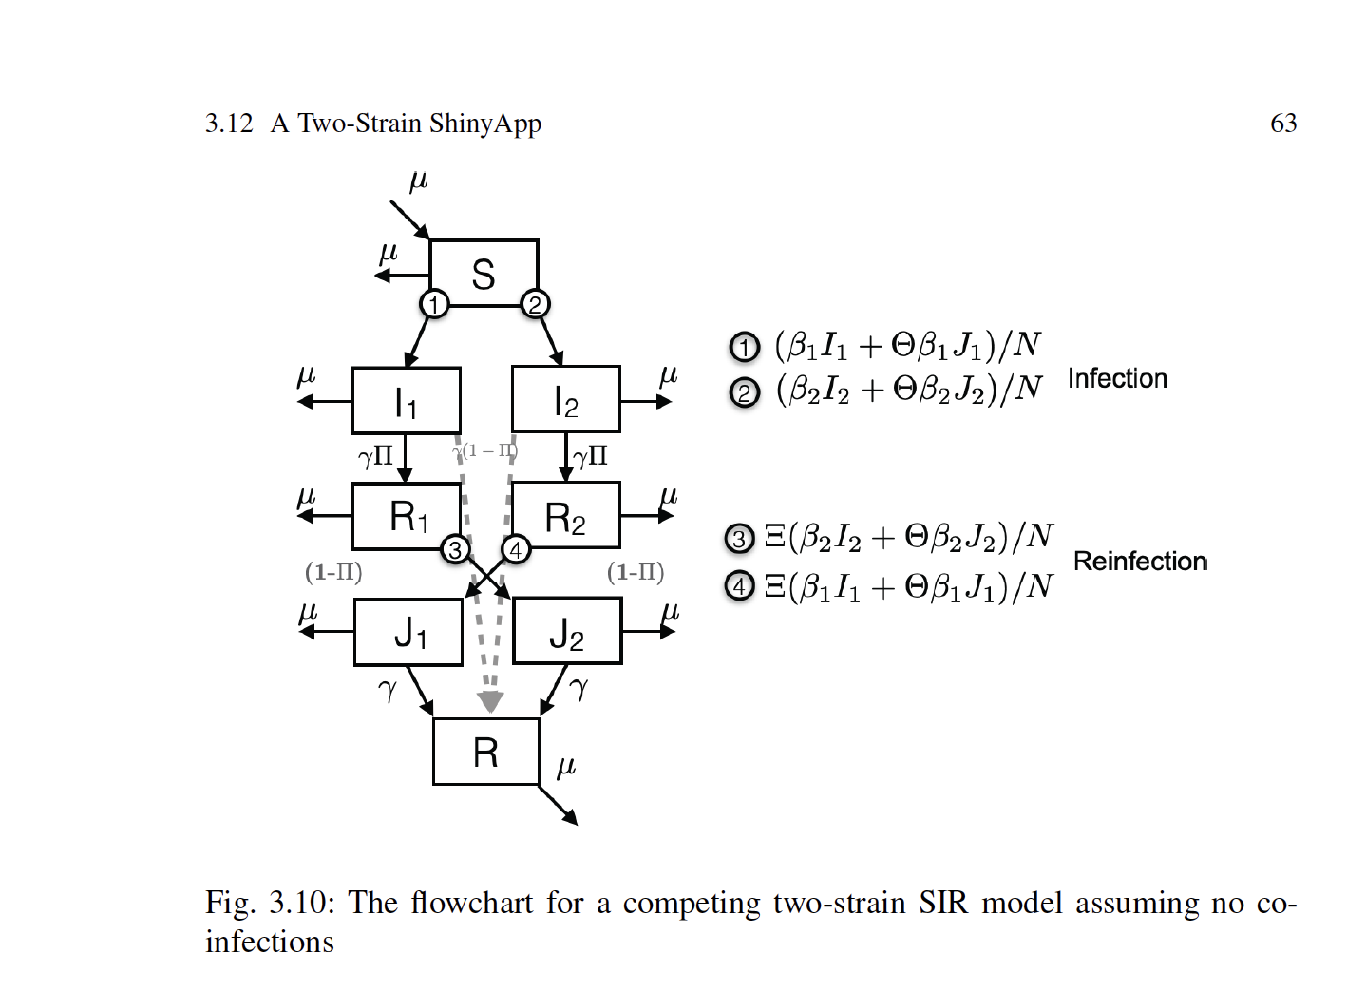

Slide 16
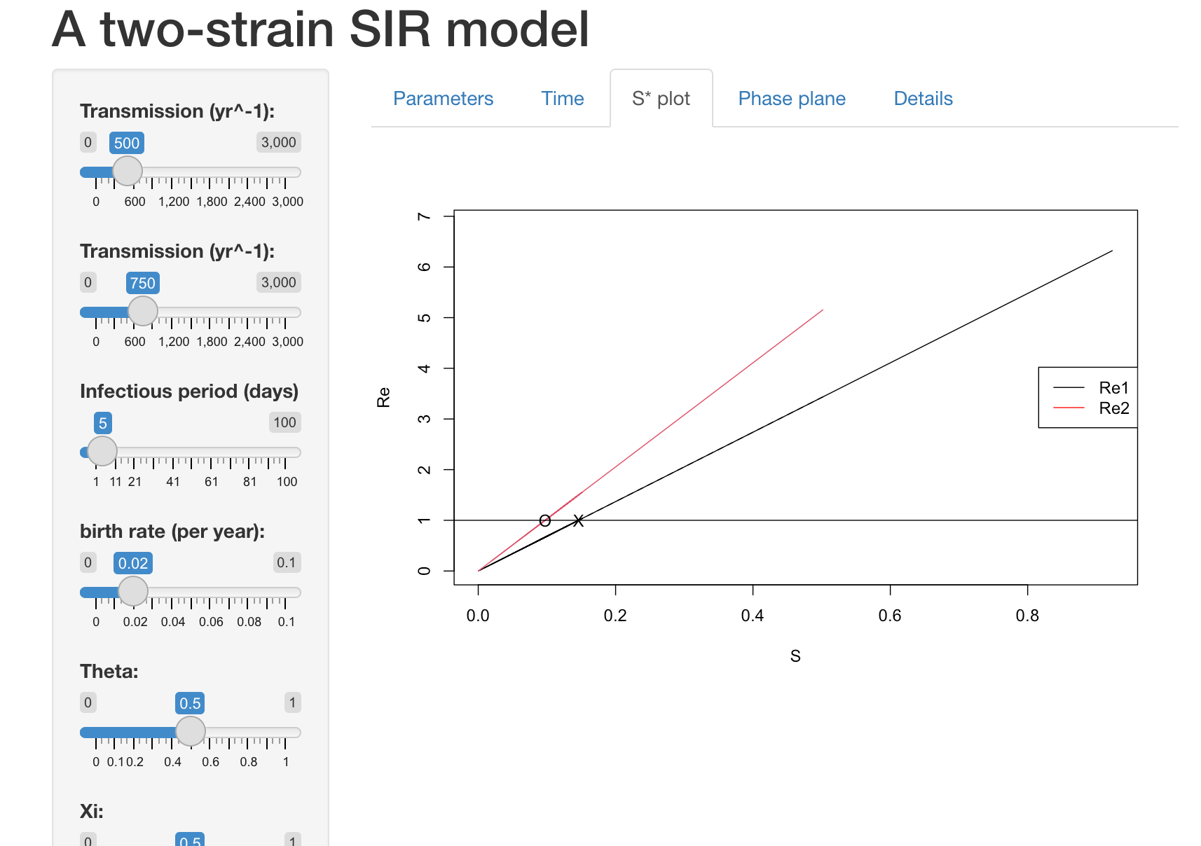
S* =1/R₀
Whichever variant has the highest R₀ will replace others
(Completely analogous to Tilman’s R* theory of plant competition)

Slide 17
Recurrent epidemics and spatial movemen

Slide 18
> Seir.app

Slide 19
Modeling spatial spread
Measles movie and spatial spread

Slide 20
Ottar Bjornstad onb1@psu.edu
CRAN:
https://cran.r-project.org/package=epimdr
Interactive apps:
https://github.com/objornstad/ecomodelmarkdowns
PSU Epidemics MOOC <100,000 learners since 2015
https://www.coursera.org/learn/epidemics

